Slide 1
GRC Training for
IS&T Business Systems Analysts
June 17, 2013

Slide 2
GRC Training Agenda
      Minutes
  SOD and GRC Project Highlights /Impact 5
  GRC System – what’s been implemented 10
  Business Systems Analyst responsibilities 5
  Training Materials and GRC Documentation 5
  Break 5
  BSA Role in detail 90
  Break 5
  GRC Reports demo / hands on 60

Slide 3
SOD and GRC Project Highlights
SOD Project Achievements
  Eliminated or Mitigated access issues in VPF
  Implemented a job-related “Role” based framework for provisioning user access
GRC Project Achievements
  VPF and IS&T are using the Emergency Access (FireFighter) feature
  MIT is using the Access Risk Analysis reports for SOD and Critical access reviews
  MIT-specific “Mitigation Controls” are assigned to Users, where access risks cannot be removed

Slide 4
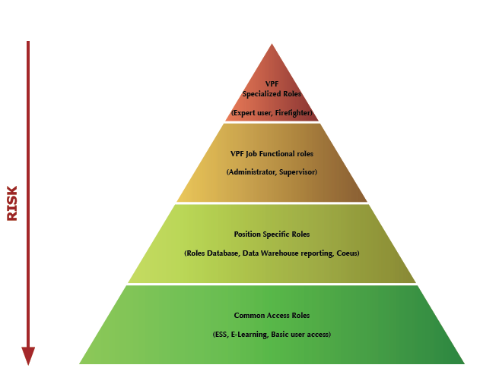
Defining SAP Roles

Slide 5
Project Goal – Before and After
Legacy
Approach
New
Method
Employee 1
Employee 2
Employee 1
Employee 2
Job Role 1
Job Role 2
Segregation of Duties
Customer Creation
Invoice / Billing
Customer
Creation
Invoice / Billing
High Risk
Lower Risk
Vague system for requesting access
No access reports for managers
Employees retained access after transfers
Access determined arbitrarily
Access and risks defined, documented, and monitored
Defined process for modifying access
Defined roles for access ownership and risk ownership
Mitigation reports

Slide 6
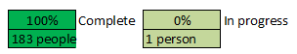
SOD Project Overall Status
Overall Project Status: | On Target

Slide 7
SOD and GRC Project Impact
  Business management responsibilities
    Risk Owners – risk and mitigation control approvals
    Role Owners (supported by BAs and BSAs)
      - access role design and assignments
      - risk and mitigation control analysis
  Periodic procedures for validating
    SAP User Access – roles per user, and users per role
    GRC FireFighter user assignments
    GRC Mitigation Controls and user assignments

Slide 8
GRC System Overview

Slide 9
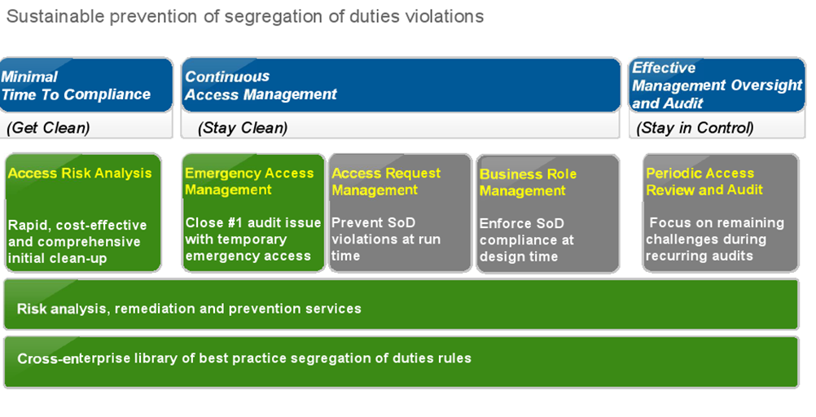
SAP Access Control

Slide 10
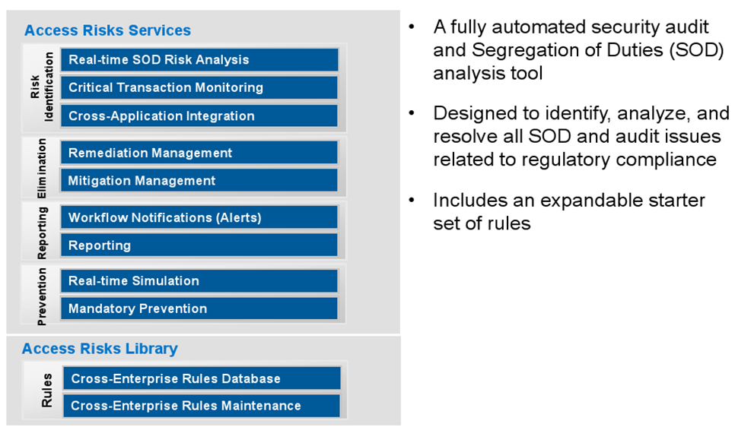
Access Control Analysis

Slide 11
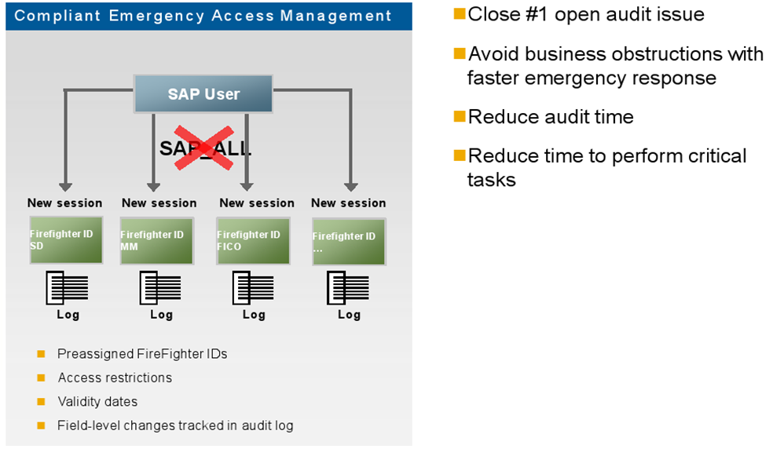
Emergency Access Management

Slide 12
EAM Roles and Responsibilities
FireFighter ID - Key Concept
  GRC-EAM object – linked to the SAP ECC Firefighter user which has the emergency access
FireFighter ID - Owner
  Approves assignment of a Firefighter IDs to users
FireFighter ID - Controller
  Reviews and approves logs from completed FireFighter ID sessions
FireFighter ID - User
  Has one or more Firefighter IDs assigned

Slide 13
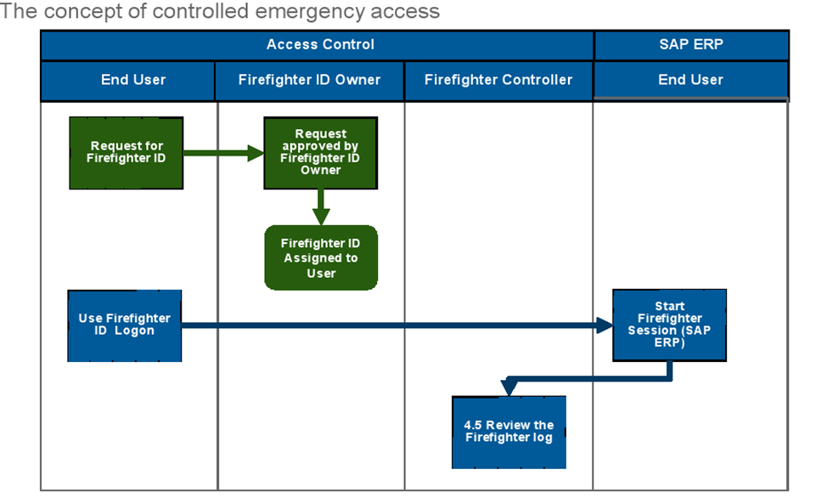
Emergency Access Management

Slide 14
EAM / FireFighter
Any Questions ?

Slide 15
GRC Documentation Overview
Training Documentation:
  Roles and Responsibilities – Business Systems Analyst
  Flowcharts (5) with supporting overview and detailed step-by-step descriptions
  GRC Report Job Aids
  Terminology used in the GRC System and for SAP Access
  Roles and Responsibilities – All GRC users
  SOD Analysis Steps
  Change request form(FireFighter ID, Mitigation Controls), Role Change / User provisioning checklist
  Business events triggering an SAP access change requirement
Additional Documentation:
  FireFighter procedures

Slide 16
IS&T BSA Role Overview
GRC Processes and IS&T BSA involvement
  1 New or Amended Roles Medium
  2 Mitigation Analysis/Design Medium
  3 New User / Role Provisioning Very Light
  4 FireFighter Maintenance/Use FF use only
  5 Periodic Compliance reviews Light

Slide 17
BREAK 1
BRIEF 5 MINUTE BREAK

Slide 18
IS&T BSA Role Overview -1
GRC Processes and VPF BSA involvement
  1 New or Amended Roles Medium
  2 Mitigation Analysis/Design Medium
  3 New User / Role Provisioning Very Light
  4 FireFighter Maintenance/Use FF use only
  5 Periodic Compliance reviews Light

Slide 19
IS&T BSA Role Overview - 2
Key Concept : use of “Composite” Roles for a job
    Reduces the provisioning workload and risk
    A Composite Role contains several “Single” roles
        Job specific or job specific combinations
        Common to the VPF business area
        Common to VPF
        Common to MIT employees
        Common to MIT
  MIT Roles Database still used for some access

Slide 20
IS&T BSA Role – In Detail - 1
GRC Processes and BSA involvement
  1 New or Amended Roles Medium involvement
    Support Role Owners and VPF BAs in general design
    Communicate design to R/3 Security Admin :
      New / changed single roles and composite roles
      Activity (tcode) and Permission (Auth Object) data
      GRC categorization of “Z” tcodes
    Assist with initial role testing
    Additional Resource : Events triggering role changes

Slide 21
IS&T BSA Role – In Detail - 2
GRC Processes and BSA involvement
  2 Mitigation Analysis/Design Medium involvement
    Assist with identifying existing controls
    Assist with selecting best mitigation option
    Assist with implementing new Mitigation Controls
        Assist in design options – configuration, enhancements, additional reports and related tcodes
        Create mini-spec documents
        Help coordinate all related transports, if not on one
    Additional Resource : SOD Analysis Steps document

Slide 22
IS&T BSA Role – In Detail - 3
GRC Processes and BSA involvement
  3 New User / Role Provisioning Should be very light
    Composite Roles – has reduced the workload
      All the work was in the Role maintenance process
      User has a pre-tested job-related composite role
    May need to assist Role Owner / BAs to check User or Role access details, particularly at the Permission / Auth Object level

Slide 23
IS&T BSA Role – In Detail - 4
GRC Processes and BSA involvement
  4 FireFighter Maintenance/Use FF use only
    No involvement in FFID assignments
    Using your FFIDs – already trained
    BA’s will assist Business FFID Controllers to review logs – BA’s may need some assistance from BSA’s to interpret the logs – see next slide.

Slide 24
EAM Roles and Responsibilities
FireFighter ID - Key Concept
  GRC-EAM object – linked to the SAP ECC Firefighter user which has the emergency access
FireFighter ID - Owner
  Approves assignment of a Firefighter IDs to users
FireFighter ID - Controller
  Reviews and approves logs from completed FireFighter ID sessions
FireFighter ID - User
  Has one or more Firefighter IDs assigned

Slide 25
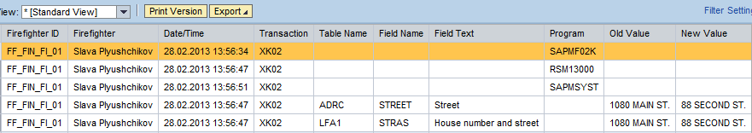
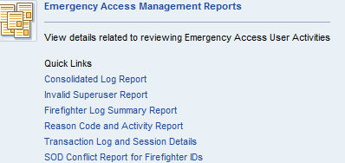
Firefighter Logs and Reports
Example of a log when data has been changed:
Firefighter Log Summary Reports can also be viewed or downloaded as from the NWBC screen.

Slide 26
IS&T BSA Role – In Detail - 5
GRC Processes and BSA involvement
  5 Periodic Compliance reviews Light
    Support Role Owner and BA :
      If unexpected SODs are reported – assist in understanding the tcodes and authorizations
      Fine-tuning any MIT custom mitigation reports

Slide 27
BSA Role – Detail – Questions ?
GRC Processes and BSA involvement
  Any questions or comments ?

Slide 28
BREAK 2
10 MINUTE BREAK

Slide 29
Goals for Today’s GRC Reports Session
Understand how GRC Reporting ties into your role of Business Systems Analyst
Help you get comfortable with GRC Reporting
  Introduce you to tools that are available
  Have a working session to get familiar with using GRC Reports

Slide 30
GRC Reports for BSAs
Business Systems Analysts are considered GRC Reporting Power Users and have access to all reports in scope for GRC
Business Systems Analysts will use GRC Reports to carry out responsibilities as part of the following GRC processes
  Process 1 : New or Amended Roles
  Process 2 : Mitigation Analysis

Slide 31
GRC Reports – Process 1
New Users and User Role Provisioning
  QUESTION: What single roles are assigned to this composite?
    05 Roles by Role Name
      Shows the single roles mapped to a composite role
  QUESTION: Which users have access to this role?
    06 User to Role Relationship
      Shows users that have access to a role (or set of roles)
  QUESTION: What roles does this user have?
    07 Role Relationship with User/User Group
      Shows the roles assigned to a user or set of users

Slide 32
GRC Reports – Process 1
New Users and User Role Provisioning
  QUESTION: What is the difference between these users’ access?
    08 Users by User ID
      Shows the roles assigned to users (also shows profiles in a different view)
      Sort of report data simplifies analysis
  QUESTION: What are all the roles and profiles assigned to a user?
    09 Count authorization for Users
      Shows single roles and profiles assigned to a user or set of users

Slide 33
GRC Reports – Process 1
New or Amended Roles
  QUESTIONS: What needs to go in the new role? What transactions have these users used in the past? Can we clean up roles and remove certain access? Do users even need this access?
    10 Action Usage by User, Role and Profile
      Shows transactions executed by a user over a period of time
      Shows total execution count for assigned transactions (including ‘0’ values)
      Shows last date of execution

Slide 34
GRC Reports – Process 2
Mitigation Analysis
  QUESTIONS: Are there any current controls which can be used to mitigate a new risk/SOD? Are the current controls relevant to your business area?
    11 Mitigation Control Report
      Shows Mitigation Controls along with risks they mitigate
      Shows Mitigation Control Owners
      Shows Mitigation Control Monitors

Slide 35
GRC Reports – Processes 1 & 2
New or Amended Roles & Mitigation Analysis
  QUESTIONS: Does this user (or set of users) have any unmitigated SODs? Are there any invalid controls assigned to these users?
    12 User Level
      Shows violations (SODs, critical transactions, roles & profiles) both mitigated & unmitigated
      Shows applied Mitigating Controls (valid & invalid)
  QUESTIONS: If we give this user (or set of users) this additional transaction (or role, or profile), will that cause new SODs?
    13 User Level Simulation
      Shows violations (SODs, critical transactions, roles & profiles) based on added access (transactions, roles, or profiles)

Slide 36
GRC Reports: Job Aids
Detailed procedure documents outlining how to execute each report
  Action for each step
  Screenshot
Numbered to align with the report number assigned to each report
Outline a brief use case scenario
Include steps for different scenarios
Step numbering diverges for each of the scenarios

Slide 37
Questions
?

