Slide 1
GRC Training for
Role Owners
June 5, 2013

Slide 2
GRC Training Agenda
      Minutes
  SOD and GRC Project Highlights /Impact 5
  GRC System – what’s been implemented 20
  Role Owner – responsibilities 5
  Training Materials and GRC Documentation 5
  Break 5
  Role Owner Role in detail 90
  Break 5
  GRC Reports demo / hands on 60

Slide 3
SOD and GRC Project Highlights
SOD Project Achievements
  Eliminated or Mitigated access issues in VPF
  Implemented a job-related “Role” based framework for provisioning user access
GRC Project Achievements
  VPF and IS&T are using the Emergency Access (FireFighter) feature
  MIT is using the Access Risk Analysis reports for SOD and Critical access reviews
  MIT-specific “Mitigation Controls” are assigned to Users, where access risks cannot be removed

Slide 4
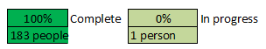
SOD Project Overall Status
Overall Project Status: | On Target

Slide 5
SOD and GRC Project Impact
  Business management responsibilities
    Risk Owners – risk and mitigation control approvals
    Role Owners (supported by BAs and BSAs)
      - access role design and assignments
      - risk and mitigation control analysis
  Periodic procedures for validating
    SAP User Access – roles per user, and users per role
    GRC FireFighter user assignments
    GRC Mitigation Controls and user assignments

Slide 6
GRC System Overview

Slide 7
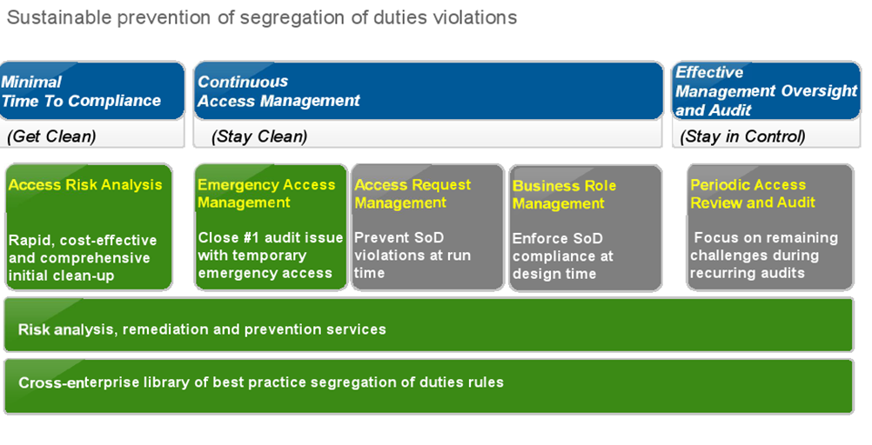
SAP Access Control

Slide 8
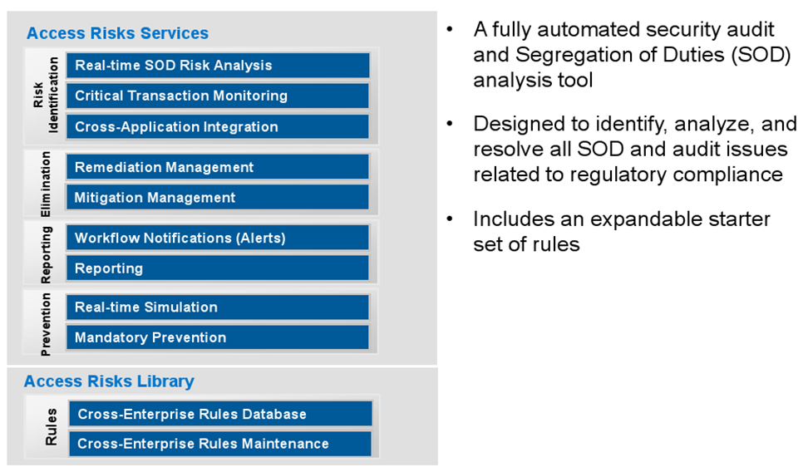
Access Control Analysis

Slide 9
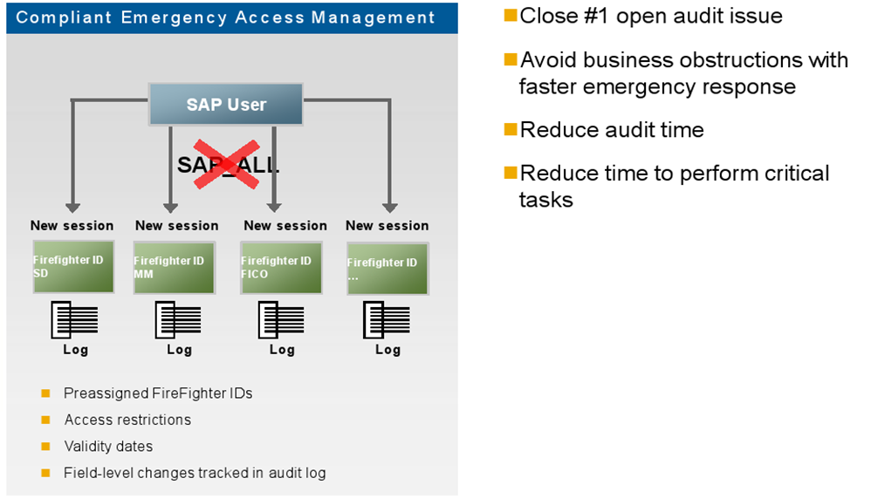
Emergency Access Management

Slide 10
EAM Roles and Responsibilities
FireFighter ID - Key Concept
  GRC-EAM object – linked to the SAP ECC Firefighter user which has the emergency access
FireFighter ID - Owner
  Approves assignment of a Firefighter IDs to users
FireFighter ID - Controller
  Reviews and approves logs from completed FireFighter ID sessions
FireFighter ID - User
  Has one or more Firefighter IDs assigned

Slide 11
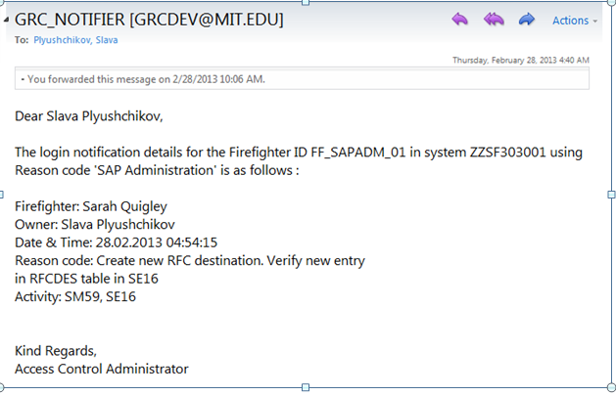
Notification to Firefighter ID Controller
An email notification is sent to the Firefighter ID Controller at the start of a Firefighter session
Email includes details which were provided by the Firefighter user during login process

Slide 12
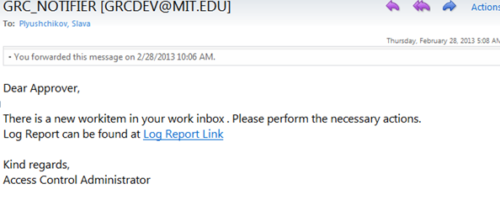
Firefighter session log approval request
An approval request email is sent to the Firefighter ID Controller after the session with a link to view the log in their workflow inbox.

Slide 13
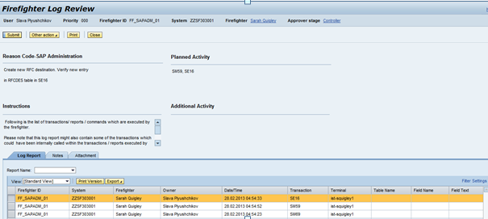
Firefighter ID Controller reviews log
The Firefighter ID Controller has several options :
  Click the Submit button to approve the activities in the log
    OR
  Under Other Actions, Select Hold, or send a request back to the Firefighter ID user for additional information

Slide 14
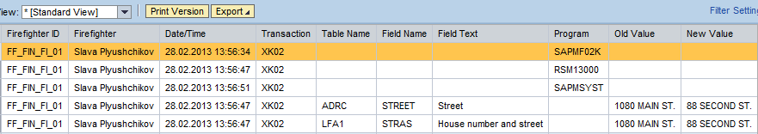
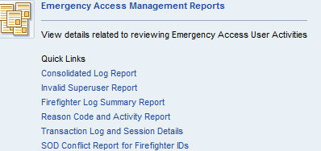
Firefighter Logs and Reports
Example of a log when data has been changed:
Firefighter Log Summary Reports can also be viewed or downloaded as from the NWBC screen.

Slide 15
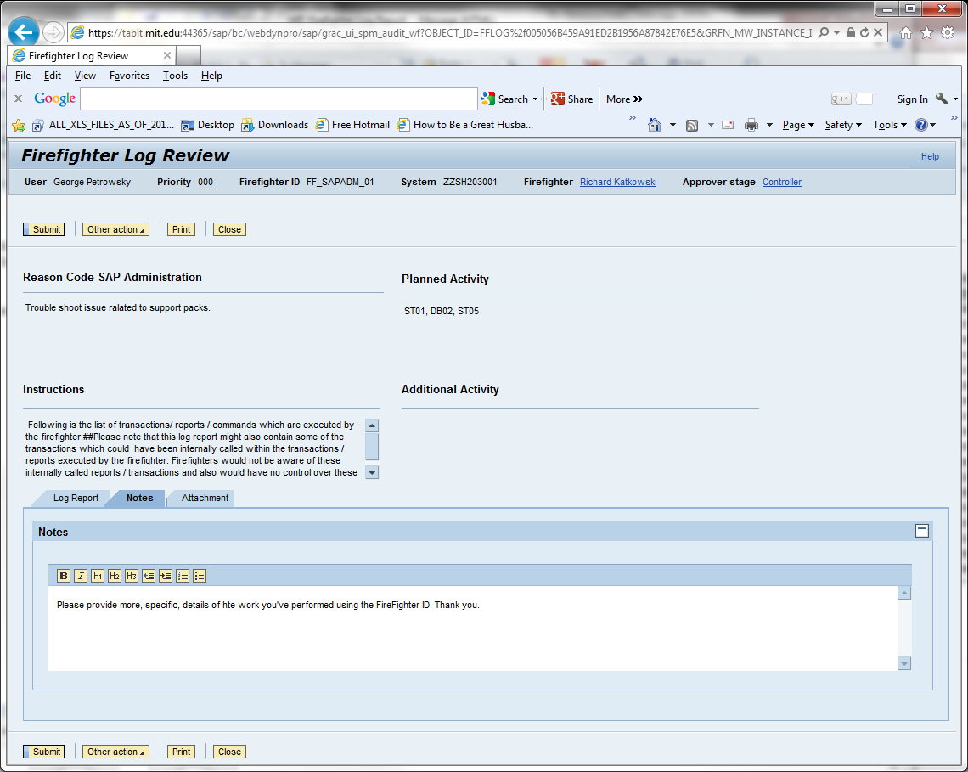
Controller requests more information
Example of a how a Controller can request more information from a Firefighter about a session

Slide 16
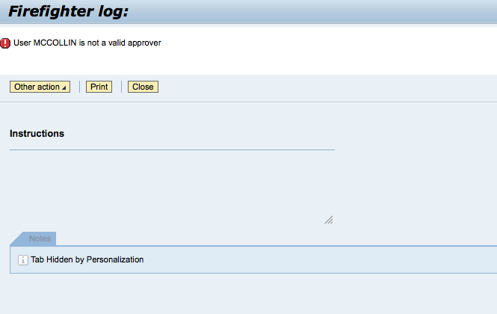
FireFighter Log review - 2 Controllers
Both Controllers will receive the Firefighter session Notification and Log Approval request emails, however only one Controller will be able to take action on the log by clicking on the Submit, Other Actions buttons. The Controller who clicks on the Log after another Controller has already taken action will receive the following message

Slide 17
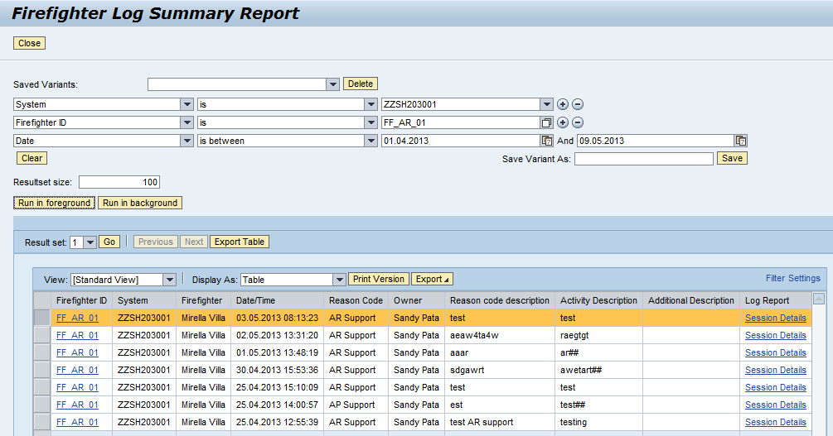
FireFighter Log access - 2 Controllers
For Firefighter IDs when there are two Controllers, they should coordinate to determine who will be primary.
The second Controller can run the Firefighter Log Summary Report to see the details of the session.

Slide 18
EAM / FireFighter
Any Questions ?

Slide 19
GRC Documentation Overview
Training Documentation:
  Roles and Responsibilities – Role Owner
  Flowcharts (5) with supporting overview and detailed step-by-step descriptions
  GRC Report Job Aids
  Terminology used in the GRC System and for SAP Access
  Roles and Responsibilities – All GRC users
  SOD Analysis Steps
  Change request form(FireFighter ID, Mitigation Controls), Role Change / User provisioning checklist
  Business events triggering an SAP access change requirement
Additional Documentation:
  FireFighter procedures

Slide 20
Role Owner Role - Overview
GRC Processes Role Owner
Involvement
  1 New or Amended Roles Medium
  2 Mitigation Analysis/Design Medium
  3 New User / Role Provisioning Medium
  4 FireFighter Maintenance/Use Medium
  5 Periodic Compliance reviews Medium

Slide 21
BREAK 1
BRIEF 5 MINUTE BREAK

Slide 22
Role Owner Role - Overview
GRC Processes Role Owner
Involvement
  1 New or Amended Roles Medium
  2 Mitigation Analysis/Design Medium
  3 New User / Role Provisioning Medium
  4 FireFighter Maintenance/Use Medium
  5 Periodic Compliance reviews Medium

Slide 23
Role Owner Role – “Roles”
Key Concept : use of “Composite” Roles for a job
    Reduces the provisioning workload and risk
    A Composite Role contains several “Single” roles
        Job specific or job specific combinations
        Common to the VPF business area
        Common to VPF
        Common to MIT employees
        Common to MIT
  MIT Roles Database still used for some access

Slide 24
Role Owner Role – Detail 1
GRC Processes and Role Owner involvement
  1 New or Amended Roles Medium
    Propose new roles or amendments to current roles
    Assist in review of new risks for new/amended roles
    Approve role design/redesign and Production update after testing and access risk analysis
    Closure of task
    Additional Resource : Events triggering role changes

Slide 25
Role Owner Role – Detail 2
GRC Processes and Role Owner involvement
  2 Mitigation Analysis/Design Medium
    Contribute advice to Mitigation Analysis
    Recommend final Mitigation strategy to Risk Owner
    Implement any new manual Mitigation controls
    Manage execution of Mitigation controls
    Additional Resource : SOD Analysis Steps document

Slide 26
Role Owner Role – Detail 3
GRC Processes and Role Owner involvement
  3 New User / Role Provisioning Medium
    Key Concept : use of Composite Roles for a job
      Reduces the provisioning workload and risk
      All the work is now in the Role maintenance process
    Role Owner has the responsibility for change requests
    Proposed Mitigation Control assignment to User
      Role Owner / VPF BA prepare documentation
      GRC is updated by IS&T GRC Administration

Slide 27
Role Owner Role – Detail 4
GRC Processes and Role Owner involvement
  4 FireFighter Maintenance/Use Medium
    If Role Owner can also be FireFighter ID owner
      Approve Assignment of MIT Users to FFIDs

Slide 28
Role Owner Role – Detail 5
GRC Processes and Role Owner involvement
  5 Periodic Compliance reviews Medium
    Review results of periodic Compliance reviews
      Where unexpected Access Risks are reported
      If Mitigation Control reports have unusual activity
    Assist Risk Owner
      Recertification of Mitigation Control assignment

Slide 29
Role Owner Role – Detail
GRC Processes and Role Owner involvement
  Any questions or comments ?

Slide 30
GRC Reports Session
  GRC Reporting for Role Owners

Slide 31
Goals for Today’s GRC Reports Session
Understand how GRC Reporting ties into your role as Role Owners
Help you get comfortable with the GRC Reporting
  Introduce you to tools that are available
  Have a working session to get familiar with using GRC Reports

Slide 32
GRC Reports for Role Owners
MIT defines a Role Owner as:
“the person who has the responsibility for managing the SAP access and roles for their area”
Role Owners will use GRC Reports to carry out responsibilities as part of the GRC processes:
  Process 1: New or Amended Roles
  Process 2: Mitigation Analysis
  Process 3: New Users and User Role Provisioning
  Process 5: Periodic Compliance Reviews

Slide 33
GRC Reports – Process 1
New or Amended Roles
  QUESTIONS: What needs to go in the new role? What transactions have these users used in the past? Can we clean up roles and remove certain access? Do users even need this access?
    10 Action Usage by User, Role and Profile
      Shows transactions executed by a user over a period of time
      Shows total execution count for assigned transactions (including ‘0’ values)
      Shows last date of execution

Slide 34
GRC Reports – Process 2
Mitigation Analysis
  QUESTIONS: Are there any current controls which can be used to mitigate a new risk/SOD? Are the current controls relevant to your business area?
    11 Mitigation Control Report
      Shows Mitigation Controls along with risks they mitigate
      Shows Mitigation Control Owners
      Shows Mitigation Control Monitors

Slide 35
GRC Reports – Process 3
New Users and User Role Provisioning
  QUESTION: What single roles are assigned to this composite?
    05 Roles by Role Name
      Shows the single roles mapped to a composite role
  QUESTION: What roles and profiles need to be added for two users to have the exact same access?
    08 Users by User ID
      Shows the roles assigned to users (also shows profiles in a different view)
      Sort of report data simplifies analysis

Slide 36
GRC Reports – Process 5
Periodic Compliance Reviews
  QUESTION: Which users have access to the roles for my area?
    06 User to Role Relationship
      Shows users that have access to a role (or set of roles)
  QUESTION: What roles do users in my area have?
    07 Role Relationship with User/User Group
      Shows the roles assigned to a user or set of users
  QUESTION: What roles and profiles do users in my area have?
    09 Count authorization for Users
      Shows single roles and profiles assigned to a user or set of users

Slide 37
GRC Reports: Job Aids
Detailed procedure documents outlining how to execute each report
  Action for each step
  Screenshot
Numbered to align with the report number assigned to each report
Outline page gives info on report use and different usage scenarios
Include steps for different scenarios
Step numbering diverges for each of the scenarios

Slide 38
Working Session
Follow Job Aids for:
GRC
06 User to Role Relationship
07 Role Relationship with User/User Group
09 Count authorization for Users
10 Action Usage by User, Role and Profile
11 Mitigation Control Report
SUIM
05 Roles by Role Name
08 Users by User ID

