Slide 1
GRC Training for
Role Owners
June 4, 2013

Slide 2
GRC Training Agenda
      Minutes
  SOD and GRC Project Highlights /Impact 5
  GRC System – what’s been implemented 20
  Role Owner – responsibilities 5
  Training Materials and GRC Documentation 5
  Break 5
  Role Owner Role in detail 90
  Break 5
  GRC Reports demo / hands on 60

Slide 3
SOD and GRC Project Highlights
SOD Project Achievements
  Eliminated or Mitigated access issues in VPF
  Implemented a job-related “Role” based framework for provisioning user access
GRC Project Achievements
  VPF and IS&T are using the Emergency Access (FireFighter) feature
  Using Access Risk Analysis reports for SOD and Critical access reviews
  MIT-specific “Mitigation Controls” assigned to Users, where access risks cannot be removed

Slide 4
SOD and GRC Project Impact
  Business management responsibilities
    Risk Owners – risk and mitigation control approvals
    Role Owners – access role design and assignments
        Supported by BAs and BSAs
  Periodic procedures for validating
    SAP User Access
    GRC FireFighter assignments
    GRC Mitigation Controls and user assignments

Slide 5
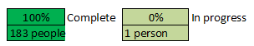
SOD/GRC Project Overall Status
Overall Project Status: | On Target

Slide 6
GRC System Overview

Slide 7
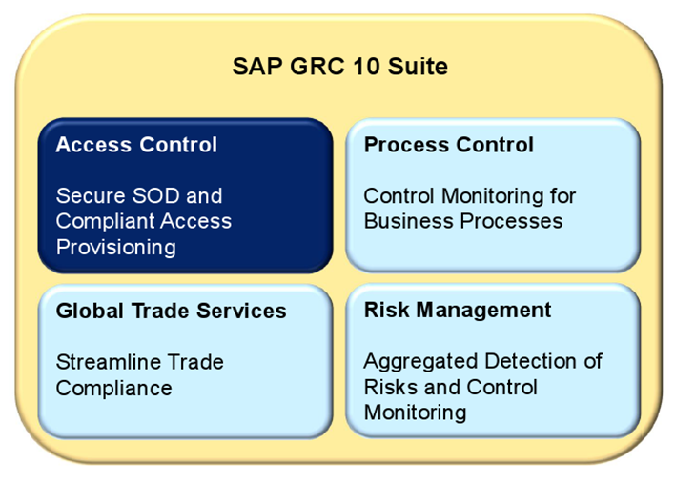
SAP GRC Suite

Slide 8
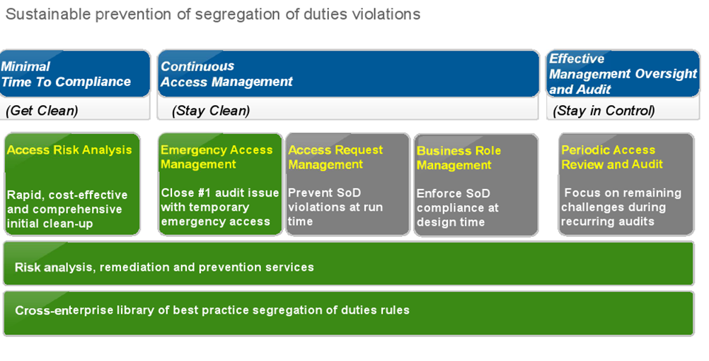
SAP Access Control

Slide 9
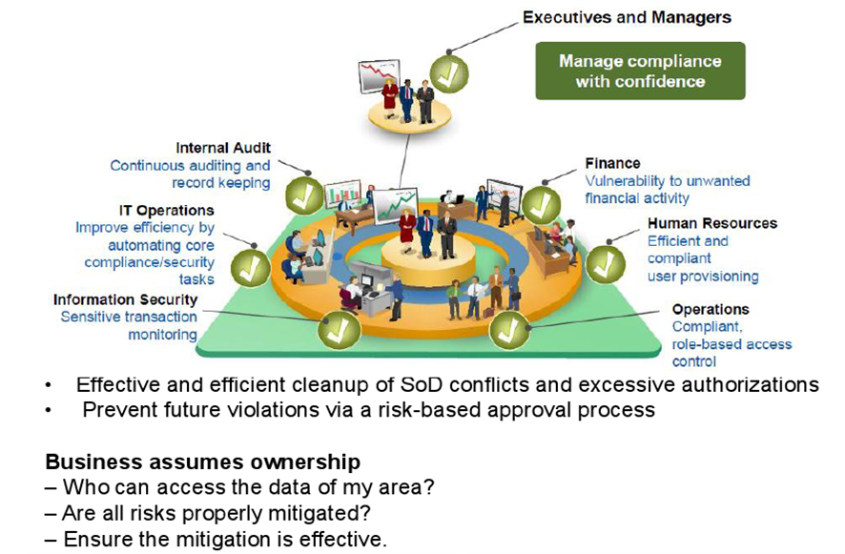
SAP Automated Solution: Access Control

Slide 10
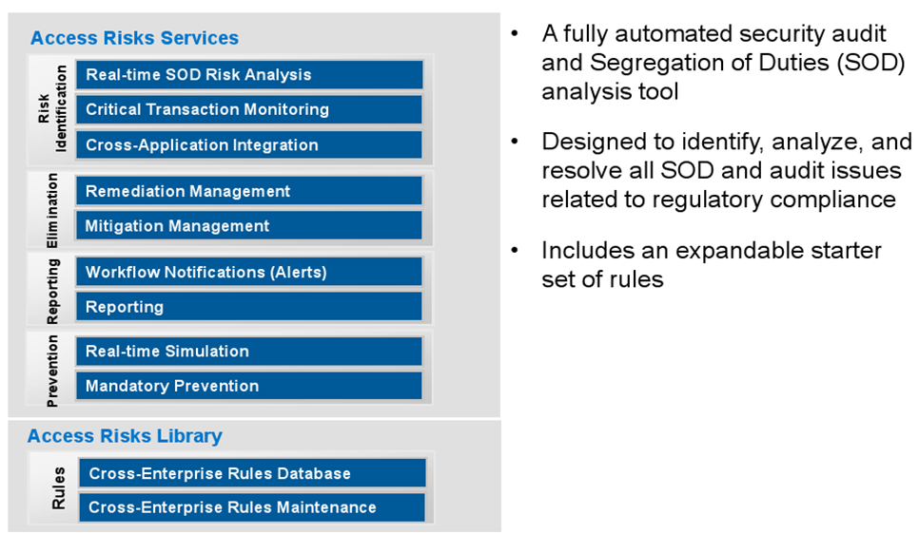
Access Control Analysis

Slide 11
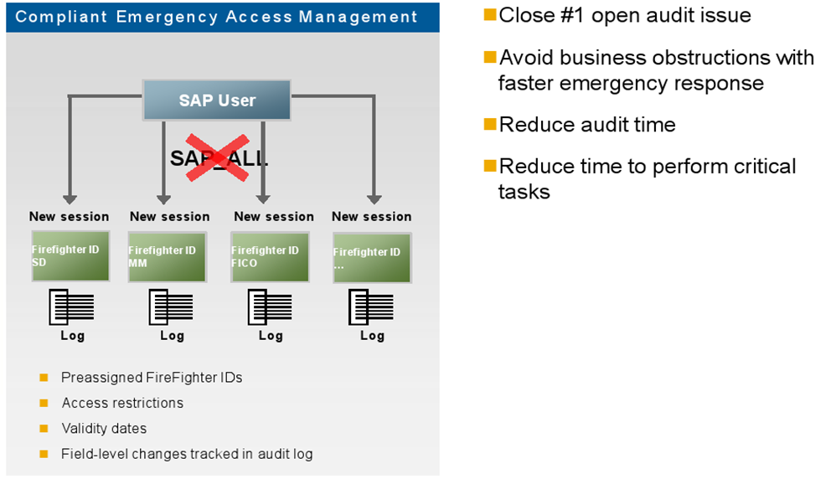
Emergency Access Management

Slide 12
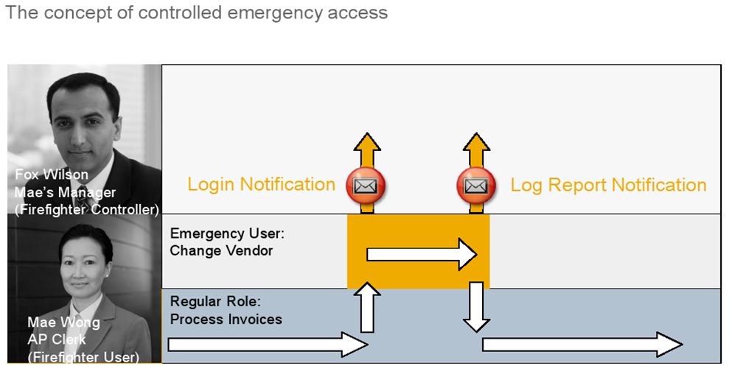
Emergency Access Management

Slide 13
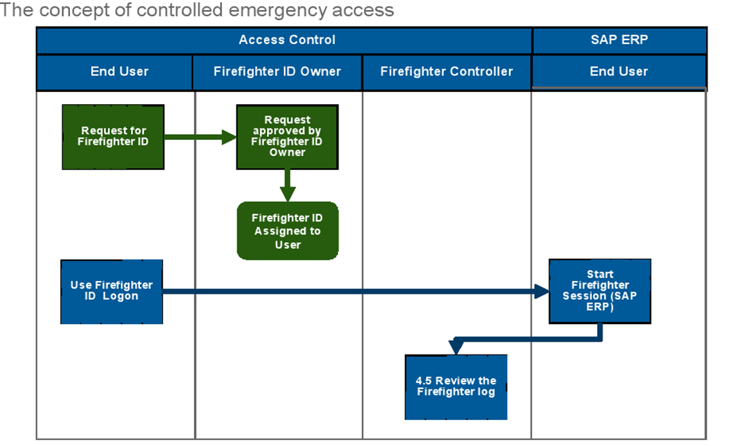
Emergency Access Management

Slide 14
EAM Roles and Responsibilities
FireFighter ID - Key Concept
  GRC-EAM object – linked to the SAP ECC Firefighter user which has the emergency access
FireFighter ID - Owner
  Approves assignment of a Firefighter IDs to users
FireFighter ID - Controller
  Reviews and approves logs from completed FireFighter ID sessions
FireFighter ID - User
  Has one or more Firefighter IDs assigned

Slide 15
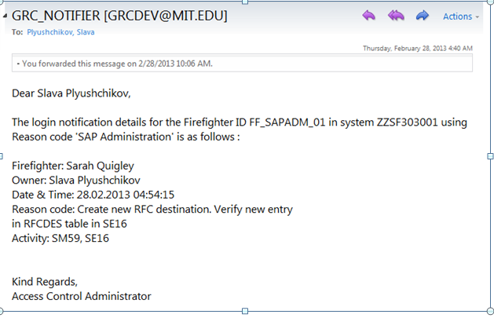
Notification to Firefighter ID Controller
An email notification is sent to the Firefighter ID Controller at the start of a Firefighter session
Email includes details which were provided by the Firefighter user during login process

Slide 16
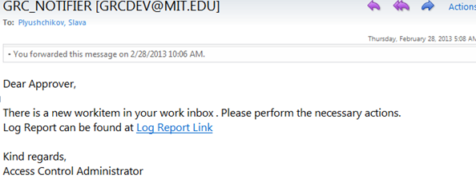
Firefighter session log approval request
An approval request email is sent to the Firefighter ID Controller after the session with a link to view the log in their workflow inbox.

Slide 17
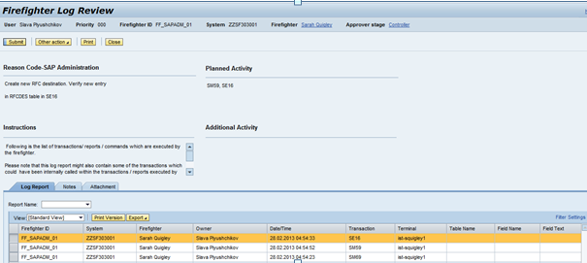
Firefighter ID Controller reviews log
The Firefighter ID Controller has several options :
  Click the Submit button to approve the activities in the log
    OR
  Under Other Actions, Select Hold, or send a request back to the Firefighter ID user for additional information

Slide 18
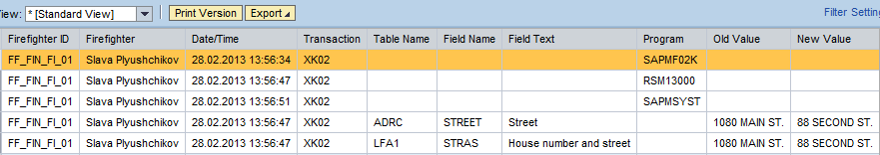
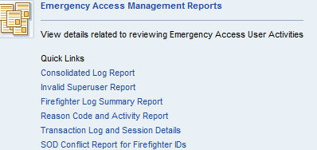
Firefighter Logs and Reports
Example of a log when data has been changed:
Firefighter Log Summary Reports can also be viewed or downloaded as from the NWBC screen.

Slide 19
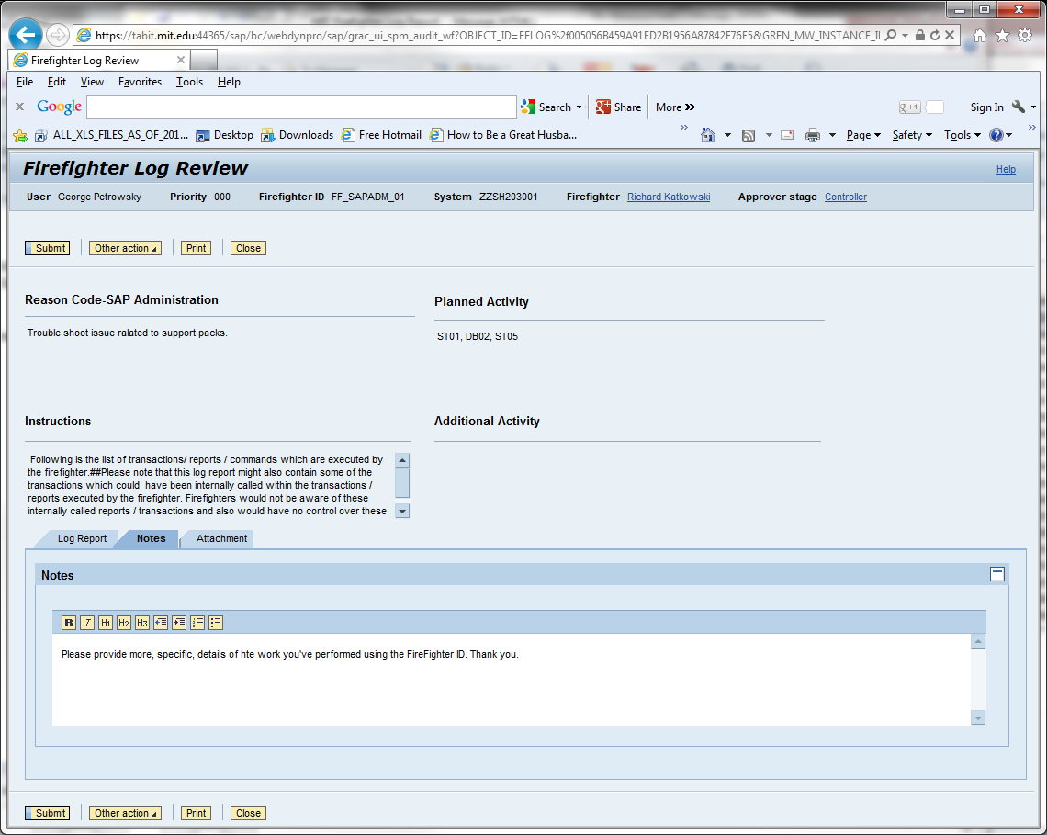
Controller requests more information
Example of a how a Controller can request more information from a Firefighter about a session

Slide 20
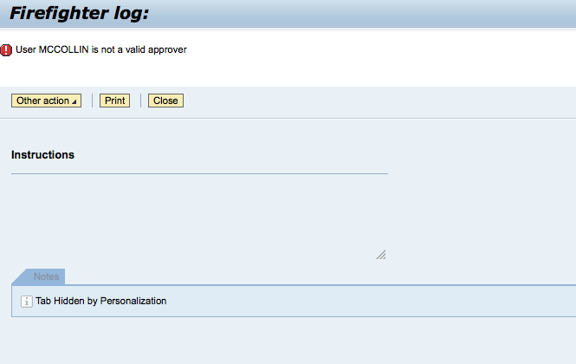
FireFighter Log review - 2 Controllers
Both Controllers will receive the Firefighter session Notification and Log Approval request emails, however only one Controller will be able to take action on the log by clicking on the Submit, Other Actions buttons. The Controller who clicks on the Log after another Controller has already taken action will receive the following message

Slide 21
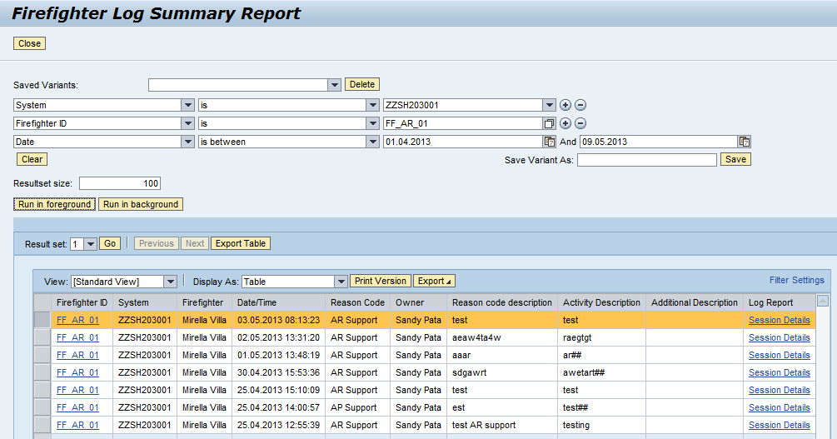
FireFighter Log access - 2 Controllers
For Firefighter IDs when there are two Controllers, they should coordinate to determine who will be primary.
The second Controller can the Firefighter Log Summary Report to see the details of the session.

Slide 22
EAM / FireFighter
Any Questions ?

Slide 23
GRC Documentation Overview
Training Documentation:
  Roles and Responsibilities – Role Owner
  Flowcharts (5) with supporting overview and detailed step-by-step descriptions
  GRC Report Job Aids
  Terminology used in the GRC System and for SAP Access
  Roles and Responsibilities – All GRC users
  SOD Analysis Steps
  Change request form(FireFighter ID, Mitigation Controls), Role Change / User provisioning checklist
  Business events triggering an SAP access change requirement
Additional Documentation:
  FireFighter procedures

Slide 24
Role Owner Role - Overview
GRC Processes Role Owner
Involvement
  1 New or Amended Roles Medium
  2 Mitigation Analysis/Design Medium
  3 New User / Role Provisioning Medium
  4 FireFighter Maintenance/Use Medium
  5 Periodic Compliance reviews Medium

Slide 25
BREAK 1
BRIEF 5 MINUTE BREAK

Slide 26
Role Owner Role - Overview
GRC Processes Role Owner
Involvement
  1 New or Amended Roles Medium
  2 Mitigation Analysis/Design Medium
  3 New User / Role Provisioning Medium
  4 FireFighter Maintenance/Use Medium
  5 Periodic Compliance reviews Medium

Slide 27
Role Owner Role – “Roles”
Key Concept : use of “Composite” Roles for a job
    Reduces the provisioning workload and risk
    A Composite Role contains several “Single” roles
        Job specific or job specific combinations
        Common to the VPF business area
        Common to VPF
        Common to MIT employees
        Common to MIT
  MIT Roles Database still used for some access

Slide 28
Role Owner Role – Detail 1
GRC Processes and Role Owner involvement
  1 New or Amended Roles Medium
    Propose new roles or amendments to current roles
    Assist in review of new risks for new/amended roles
    Approve role design/redesign and Production update after testing and access risk analysis
    Closure of task
    Additional Resource : Events triggering role changes

Slide 29
Role Owner Role – Detail 2
GRC Processes and Role Owner involvement
  2 Mitigation Analysis/Design Medium
    Contribute advice to Mitigation Analysis
    Recommend final Mitigation strategy to Risk Owner
    Implement any new manual Mitigation controls
    Manage execution of Mitigation controls
    Additional Resource : SOD Analysis Steps document

Slide 30
Role Owner Role – Detail 3
GRC Processes and Role Owner involvement
  3 New User / Role Provisioning Medium
    Key Concept : use of Composite Roles for a job
      Reduces the provisioning workload and risk
      All the work is now in the Role maintenance process
    Role Owner has the responsibility for change requests
    Proposed Mitigation Control assignment to User
      Role Owner / VPF BA prepare documentation
      GRC is updated by IS&T GRC Administration

Slide 31
Role Owner Role – Detail 4
GRC Processes and Role Owner involvement
  4 FireFighter Maintenance/Use Medium
    If Role Owner can also be FireFighter ID owner
      Approve Assignment of MIT Users to FFIDs

Slide 32
Role Owner Role – Detail 5
GRC Processes and Role Owner involvement
  5 Periodic Compliance reviews Medium
    Review results of periodic Compliance reviews
      Where unexpected Access Risks are reported
      If Mitigation Control reports have unusual activity
    Assist Risk Owner
      Recertification of Mitigation Control assignment

Slide 33
Risk Owner Role – Detail
GRC Processes and Risk Owner involvement
  Any questions or comments ?

Slide 34
GRC Reports Session
  GRC Reporting for Risk Owners

Slide 35
Goals for Today’s GRC Reports Session
Understand how GRC Reporting ties into your role as Risk Owners
Help you get comfortable with the GRC Reporting
  Introduce you to tools that are available
  Have a working session to get familiar with using GRC Reports

Slide 36
GRC Reports for Risk Owners
SAP defines Risk Owners as:
“The individual employee or employees
who have oversight responsibility”
Risk Owners will use GRC Reports to carry out responsibilities as part of the following GRC processes:
  Process 5: Periodic Compliance Reviews
    Status Monitoring (Q10)

Slide 37
GRC Reports for Risk Owners
What is the current risk exposure at MIT VPF?
  01 Risk Violations
    Can be run for Users, Roles or Profiles
    Does not show what is mitigated
    Shows risk counts by Business Processes
  02 User Analysis
    Can only be run for Users
    Shows if risks are mitigated
    Shows risk counts by Critical Actions, Roles and Profiles
Is MIT VPF increasing/decreasing risk exposure?
  03 Violations Comparisons
    Can be run for Users, Roles or Profiles

Slide 38
GRC Reports: Job Aids
Detailed procedure documents outlining how to execute each report
  Action for each step
  Screenshot
Numbered to align with the report number assigned to each report
Outline page gives info on report use and different usage scenarios
Include steps for different scenarios
Step numbering diverges for each of the scenarios

Slide 39
Working Session
Follow the GRC report Job Aids for:
        01 Risk Violations
        02 User Analysis
        03 Violations Comparisons

Slide 40
Questions
?

