Slide 1
GRC Training for
Risk Owners
June 3, 2013

Slide 2
Agenda
Training Session Agenda Mins
  Overview 30
    SOD Project
    GRC System
    Risk Owner Role
  Break 5
  Training Materials and GRC Documentation 5
  Risk Owner Role in detail 45
  GRC Reports demos / hands on 20

Slide 3
SOD Project Overview
Project Overview
  What were the Project Goals
  What is an SOD
  Why SOD is Important
Project Scope, Team and Approach
GRC Overview

Slide 4
SOD Project Goals
Build a standardized framework of SAP security roles across all VPF areas which includes :
  Redesigning SAP access roles to be job-based
  Ensuring there is adequate Segregation of Duties
    One person does not have end-to-end access to a business process
    Where possible, data entry and approvals are segregated
    Includes some re-assignment actions between jobs, remediation
  Controls in place
    Preventative – proactive, ahead of the game
    Detective – reactive, after the fact, mitigation
    Role & Risk ownership assigned to business management

Slide 5

Why SOD is Important to MIT
Prevention of fraud and abuse!
  Protecting MIT’s financial data:
    Ensuring adequate access controls are in place
    Would you know if a breach occurred?
  Business area and specific job focus :
    Business Owner: is responsible for work conducted within the business area. Needs to :
      Know what the people in the business area can do in SAP
      Ensure procedures are in place to minimize any risks
    Business Users: should only have transactions required by their current job

Slide 6
Background
MIT approach to SAP Authorizations
Approach to SAP security has been largely unchanged since implementation in late 1990’s
Distributed responsibility | Authorizations granted and removed by several hundred primary authorizers Segregation of duties not considered when granting authorizations
Designed around people, not roles | Not linked to a person’s job or employment status Individuals with more access than needed to perform their jobs
Relies on manual processes | Individuals retain authorizations related to past jobs, unless manually removed Requests via email, phone calls
Limited controls and documentation | No formal controls to identify and address segregation of duties conflicts, security risk
Delay in implementing corrective action | Limited system and business resources Other implementations have taken priority

Slide 7
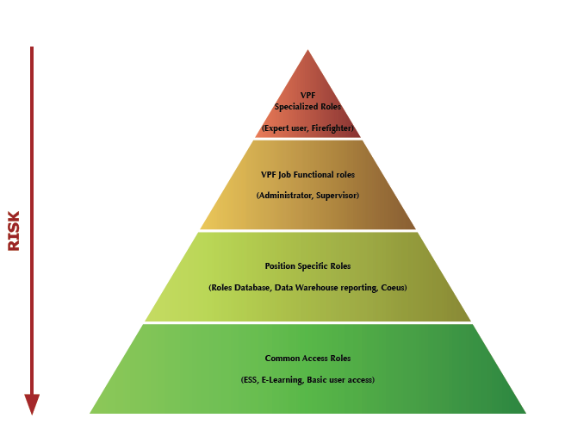
Defining SAP Roles

Slide 8
Project Goal – Before and After
Legacy
Approach
New
Method
Employee 1
Employee 2
Employee 1
Employee 2
Job Role 1
Job Role 2
Segregation of Duties
Customer Creation
Invoice / Billing
Customer
Creation
Invoice / Billing
High Risk
Lower Risk
Vague system for requesting access
No access reports for managers
Employees retained access after transfers
Access determined arbitrarily
Access and risks defined, documented, and monitored
Defined process for modifying access
Defined roles for access ownership and risk ownership
Mitigation reports

Slide 9
SOD Project Team
Executive Sponsors
Mike Howard, VPF
Marilyn Smith, IS&T
Debby Fisher, Audit
Advisory Committee
Mike Bowers, Audit
Allen Marcum, VPF
Basil Stewart, VPF
Mary Weiss, IS&T
Project Sponsors
Gerry O’Toole, VPF
Bart Dahlstrom, IS&T
Project Management
Sandy Pata, Consultant
Karon McCollin, IS&T
* Consultant
** Advisory Committee
  Business Role Owners
  John Larkin, AP
  James Walsh, HR/Payroll; Fin. Acct/Rept
  Sara Malconian, Procurement
  Rositha Durham, Procurement
  Kathy McGrath, Travel
  Danielle Khoury, Fin. Acct./Reporting
  Pamela Schickling, Sponsored Acct.
  Donna Cairns, Accts. Receivable
  Cheryl Whelan, Cashier
  Jo-anne Chute, Property
  Long Tran, Tax
  John Donnelly, Budget
  Ann Warner-Harvey, HR/Admin
  Eileen DesRosiers, Finance
Core Team
Jordan Lewis, VPF
George Petrowsky, IS&T
Jie Jiao, Audit
John Tuttle, IS&T
Tricia Sullivan-Mullen, VPF**
Siobhan Cunningham, IS&T**
Suman Sidhu, GRC SME *
Simon Cherny, GRC SME *
Inge Meyer, Roles Build *
Ronald Meyer, Roles Build *
JD Sudhakar *
Business Analysts
Mirella Villa, VPF
Scott Ball, VPF
Leslie Wright, VPF
Lody Petriv, VPF
Bob Casey, IS&T
Kristen Hann, IS&T
Ken Levie, IS&T
Gregg McGrath, IS&T
Sandeep Nandendla, Business Analyst *
Page 12
Notes:
Exec Sponsors: reflect collaborative effort between VPF, IS&T and Audit
Business Role Owners: key stakeholders on business side, primary role in design of new roles
Core Team: involved in implementation of all 14 subprojects
BAs/BSAs- involved in their areas of expertise only

Slide 10
SOD/GRC Project Overall Status
Overall Project Status: | On Target
Notes
By 5/9/2013 all but Laurie Farinella

Slide 11
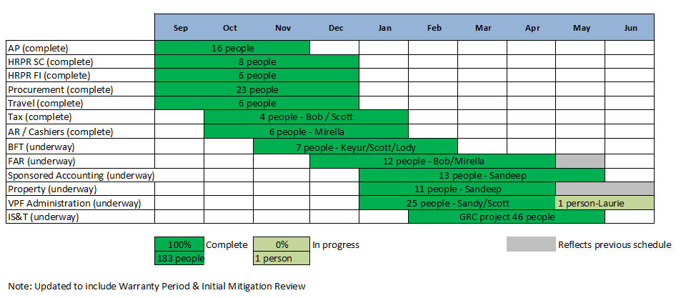
SOD/GRC Project Progress to Completion

Slide 12
GRC System Overview

Slide 13
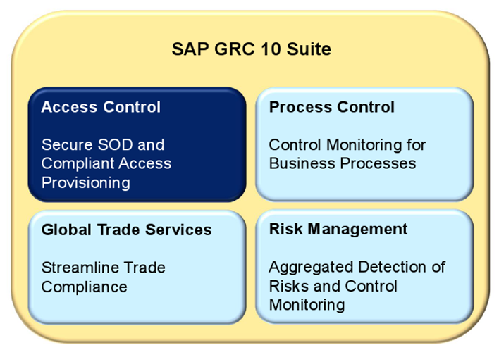
SAP GRC Suite

Slide 14
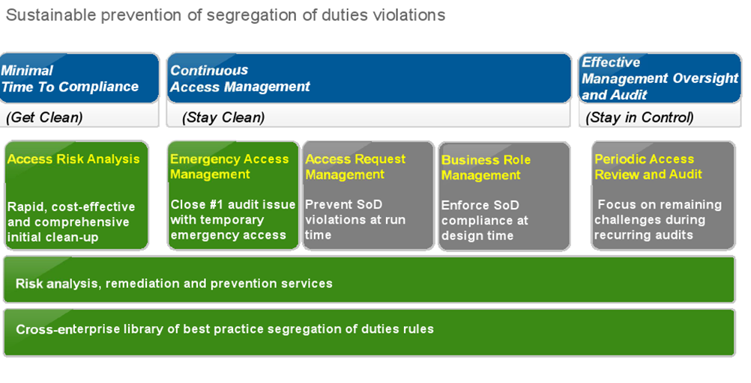
SAP Access Control

Slide 15
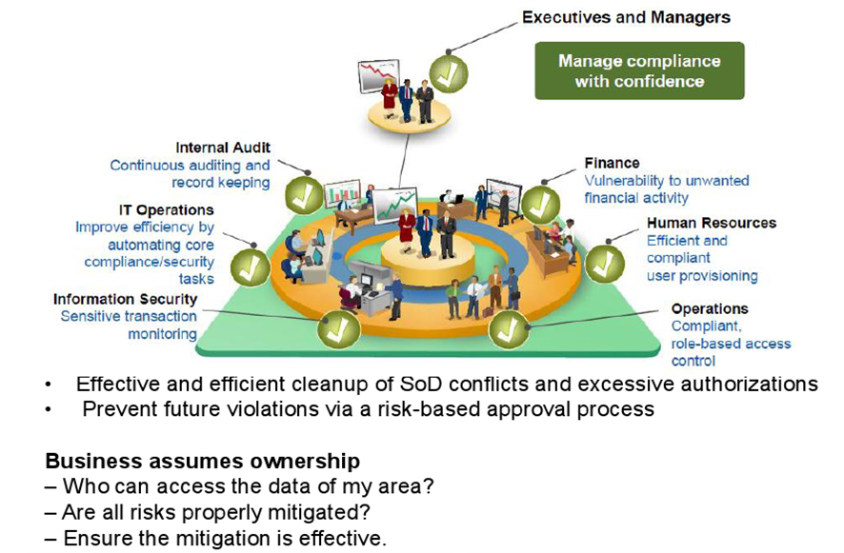
SAP Automated Solution: Access Control

Slide 16
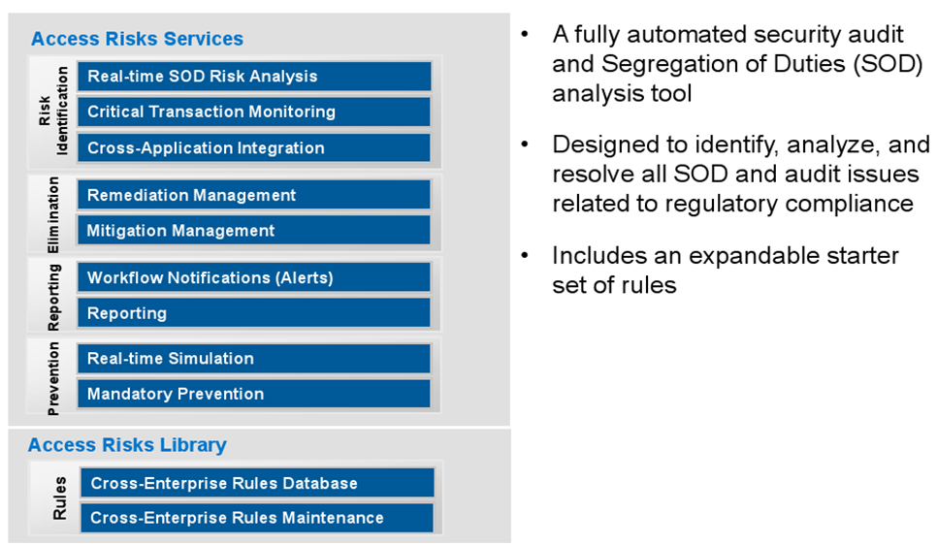
Access Control Analysis

Slide 17
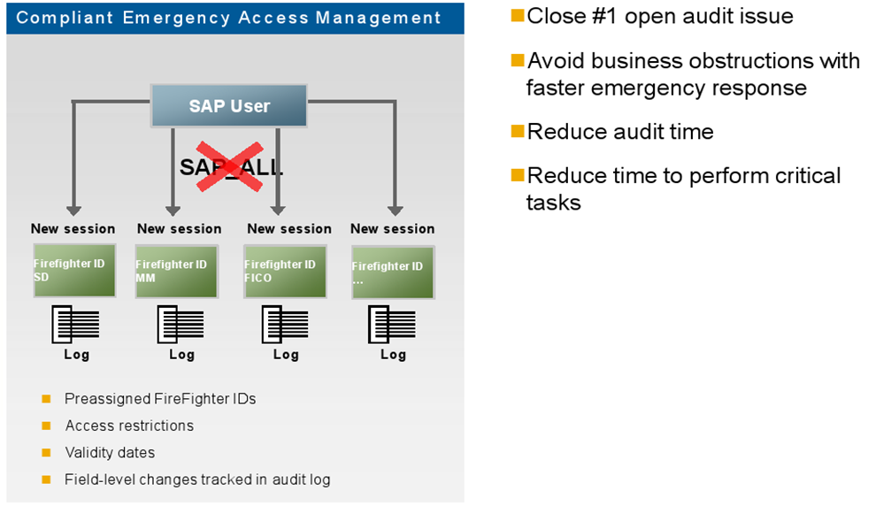
Emergency Access Management

Slide 18
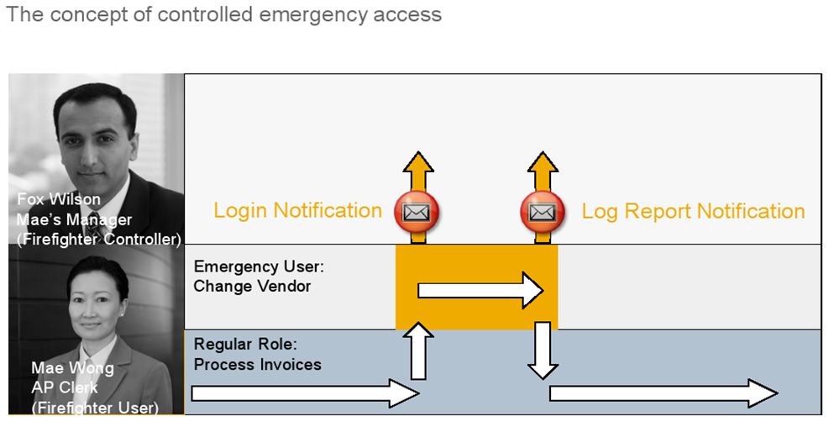
Emergency Access Management

Slide 19
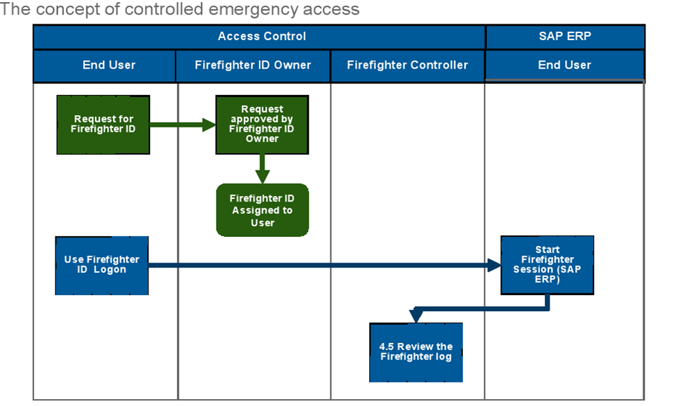
Emergency Access Management

Slide 20
GRC Training Session Overview
Role | Attendee Count | Training Sessions | Duration Estimate
BA | 4 | May 23, Little Cayman, 9-4 | 4 hrs
Risk Owners | 4 | June 3, Little Cayman, 1-3 | 2 hrs
Role Owners | 15 | June 4, 1-4, Gerry's group June 5, 9-1, Basil's group Little Cayman | 4 hrs
BSA | 16 | June 17, 1-5, Frank's group June 19 or 20, 9-1, Siobhan's group W92-206 Classroom | 4 hrs
SOD Coordinator | 1 | In All Sesions | Several days
VPF Firefighters | 12 | June 3, Little Cayman, 3-4 | 1 hr
Help Desk | 1 | See BSA times W92-206 Classroom | 6 hrs

Slide 21
GRC Documentation Overview
Training Documentation:
  Roles and Responsibilities – Risk Owner
  Flowcharts (5) with detailed step-by-step descriptions
  GRC Report Job Aids
  Terminology used in the GRC System and for SAP Access
  Roles and Responsibilities – All
  Steps for performing an SOD analysis
  Associated change request Forms / Checklists
  Business events triggering an SAP access change
Additional Documentation:
  FireFighter procedures

Slide 22
Risk Owner Role - Overview
GRC Processes Risk Owner
Involvement
  1 New or Amended Roles Very Light
  2 Mitigation Analysis/Design Medium
  3 New User / Role Provisioning Very Light
  4 FireFighter Maintenance/Use Very Light
  5 Periodic Compliance reviews Medium

Slide 23
BREAK 1
BRIEF 5 MINUTE BREAK

Slide 24
Risk Owner Role - Overview
GRC Processes Risk Owner
Involvement
  1 New or Amended Roles Very Light
  2 Mitigation Analysis/Design Medium
  3 New User / Role Provisioning Very Light
  4 FireFighter Maintenance/Use Very Light
  5 Periodic Compliance reviews Medium

Slide 25
Risk Owner Role – Detail
GRC Processes and Risk Owner involvement
  1 New or Amended Roles Very Light
    Maintain Awareness of new / changed roles
    Additional Resource : Events triggering role changes

Slide 26
Risk Owner Role – Detail
GRC Processes and Risk Owner involvement
  2 Mitigation Analysis/Design Medium
    Provide guidance on acceptable level of risk
      When new or amended roles trigger a GRC Access Risk
    Approve “Mitigation Controls” description / design
      For Mitigation controls assignment to Users - see Process 3
      For Mitigation controls / reports monitoring – see Process 5
    Additional Resource : SOD Analysis Steps document

Slide 27
Risk Owner Role – Detail
GRC Processes and Risk Owner involvement
  3 New User / Role Provisioning Very Light
    Key Concept : use of Composite Roles for a job
      Reduces the provisioning workload and risk
      Role Owner has the responsibility for this
      All the work is now in the Role maintenance process
    Approval of Mitigation Control assignment to User
      Role Owner / VPF BA prepare documentation
      GRC is updated by IS&T GRC Administration

Slide 28
Risk Owner Role – Detail
GRC Processes and Risk Owner involvement
  4 FireFighter Maintenance/Use Light
    If Risk Owner is also FireFighter ID owner
      Approve Assignment of MIT Users to FFIDs

Slide 29
Risk Owner Role – Detail
GRC Processes and Risk Owner involvement
  5 Periodic Compliance reviews Medium
    Recertification of Mitigation Control assignment
    Review results of periodic Compliance reviews
      Where unexpected SODs are reported
      If Mitigation Control reports have unusual activity

Slide 30
Risk Owner Role – Detail
GRC Processes and Risk Owner involvement
  Any questions or comments ?

Slide 31
GRC Reports Session
  GRC Reporting for Risk Owners

Slide 32
Goals for Today’s GRC Reports Session
Understand how GRC Reporting ties into your role as Risk Owners
Help you get comfortable with the GRC Reporting
  Introduce you to tools that are available
  Have a working session to get familiar with using GRC Reports

Slide 33
GRC Reports for Risk Owners
SAP defines Risk Owners as:
“The individual employee or employees
who have oversight responsibility”
Risk Owners will use GRC Reports to carry out responsibilities as part of the following GRC processes:
  Process 5: Periodic Compliance Reviews
    Status Monitoring (Q10)

Slide 34
GRC Reports for Risk Owners
What is the current risk exposure at MIT VPF?
  01 Risk Violations
    Can be run for Users, Roles or Profiles
    Does not show what is mitigated
    Shows risk counts by Business Processes
  02 User Analysis
    Can only be run for Users
    Shows if risks are mitigated
    Shows risk counts by Critical Actions, Roles and Profiles
Is MIT VPF increasing/decreasing risk exposure?
  03 Violations Comparisons
    Can be run for Users, Roles or Profiles

Slide 35
GRC Reports: Job Aids
Detailed procedure documents outlining how to execute each report
  Action for each step
  Screenshot
Numbered to align with the report number assigned to each report
Outline page gives info on report use and different usage scenarios
Include steps for different scenarios
Step numbering diverges for each of the scenarios

Slide 36
Working Session
Follow the GRC report Job Aids for:
        01 Risk Violations
        02 User Analysis
        03 Violations Comparisons

Slide 37
Working Session
Using GRC Reports to find answers to our authorizations and SOD questions.
If you have a question, try using the Job Aids or Reference Documents!
If you still have a question, please feel free to ask.

