Slide 1
GRC Training for
VPF Business Analysts
May 2013

Slide 2
Agenda
Training Session Agenda Mins
  Overview 30
    SOD Project
    GRC System
    Training materials and available documentation
    VPF Business Analyst Role
  Break 5
  VPF Business Analyst Role in detail 60
  Break 10
  GRC & SUIM Reports demos / hands on 120
    Lunch break in the middle

Slide 3
SOD Project Overview
Project Overview
  What were the Project Goals
  What is an SOD
  Why SOD is Important
Project Scope, Team and Approach
GRC Overview

Slide 4
SOD Project Goals
Build a standardized framework of SAP security roles across all VPF areas which includes :
  Redesigning SAP access roles to be job-based
  Ensuring there is adequate Segregation of Duties
    One person does not have end-to-end access to a business process
    Where possible, data entry and approvals are segregated
    Includes some re-assignment actions between jobs, remediation
  Controls in place
    Preventative – proactive, ahead of the game
    Detective – reactive, after the fact, mitigation
    Role & Risk ownership assigned to business management

Slide 5

Why SOD is Important to MIT
Prevention of fraud and abuse!
  Protecting MIT’s financial data:
    Ensuring adequate access controls are in place
    Would you know if a breach occurred?
  Business area and specific job focus :
    Business Owner: is responsible for work conducted within the business area. Needs to :
      Know what the people in the business area can do in SAP
      Ensure procedures are in place to minimize any risks
    Business Users: should only have transactions required by their current job

Slide 6
Background
MIT approach to SAP Authorizations
Approach to SAP security has been largely unchanged since implementation in late 1990’s
Distributed responsibility | Authorizations granted and removed by several hundred primary authorizers Segregation of duties not considered when granting authorizations
Designed around people, not roles | Not linked to a person’s job or employment status Individuals with more access than needed to perform their jobs
Relies on manual processes | Individuals retain authorizations related to past jobs, unless manually removed Requests via email, phone calls
Limited controls and documentation | No formal controls to identify and address segregation of duties conflicts, security risk
Delay in implementing corrective action | Limited system and business resources Other implementations have taken priority

Slide 7
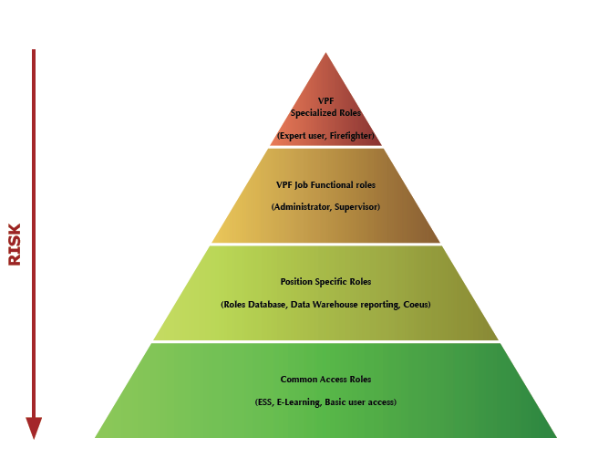
Defining SAP Roles

Slide 8
Project Goal – Before and After
Legacy
Approach
New
Method
Employee 1
Employee 2
Employee 1
Employee 2
Job Role 1
Job Role 2
Segregation of Duties
Customer Creation
Invoice / Billing
Customer
Creation
Invoice / Billing
High Risk
Lower Risk
Vague system for requesting access
No access reports for managers
Employees retained access after transfers
Access determined arbitrarily
Access and risks defined, documented, and monitored
Defined process for modifying access
Defined roles for access ownership and risk ownership
Mitigation reports

Slide 9
SOD Project Team
Executive Sponsors
Mike Howard, VPF
Marilyn Smith, IS&T
Debby Fisher, Audit
Advisory Committee
Mike Bowers, Audit
Allen Marcum, VPF
Basil Stewart, VPF
Mary Weiss, IS&T
Project Sponsors
Gerry O’Toole, VPF
Bart Dahlstrom, IS&T
Project Management
Sandy Pata, Consultant
Karon McCollin, IS&T
* Consultant
** Advisory Committee
  Business Role Owners
  John Larkin, AP
  James Walsh, HR/Payroll; Fin. Acct/Rept
  Sara Malconian, Procurement
  Rositha Durham, Procurement
  Kathy McGrath, Travel
  Danielle Khoury, Fin. Acct./Reporting
  Pamela Schickling, Sponsored Acct.
  Donna Cairns, Accts. Receivable
  Cheryl Whelan, Cashier
  Jo-anne Chute, Property
  Long Tran, Tax
  John Donnelly, Budget
  Ann Warner-Harvey, HR/Admin
  Eileen DesRosiers, Finance
Core Team
Jordan Lewis, VPF
George Petrowsky, IS&T
Jie Jiao, Audit
John Tuttle, IS&T
Tricia Sullivan-Mullen, VPF**
Siobhan Cunningham, IS&T**
Suman Sidhu, GRC SME *
Simon Cherny, GRC SME *
Inge Meyer, Roles Build *
Ronald Meyer, Roles Build *
JD Sudhakar *
Business Analysts
Mirella Villa, VPF
Scott Ball, VPF
Leslie Wright, VPF
Lody Petriv, VPF
Bob Casey, IS&T
Kristen Hann, IS&T
Ken Levie, IS&T
Gregg McGrath, IS&T
Sandeep Nandendla, Business Analyst *
Page 12
Notes:
Exec Sponsors: reflect collaborative effort between VPF, IS&T and Audit
Business Role Owners: key stakeholders on business side, primary role in design of new roles
Core Team: involved in implementation of all 14 subprojects
BAs/BSAs- involved in their areas of expertise only

Slide 10
SOD/GRC Project Overall Status
Overall Project Status: | On Target
Notes
By 5/9/2013 all but Laurie Farinella

Slide 11
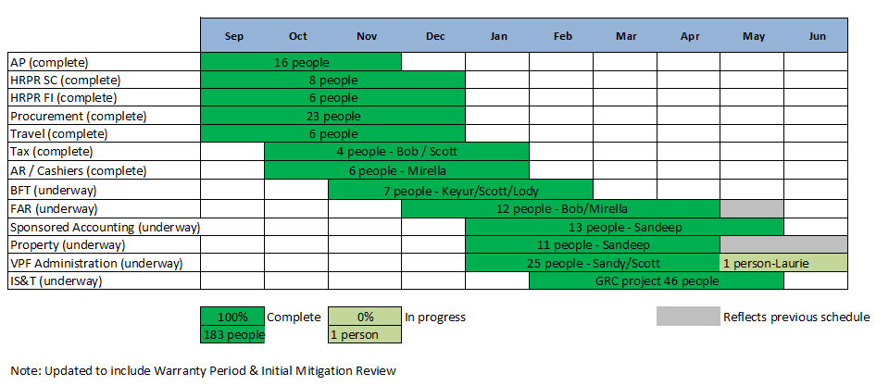
SOD/GRC Project Progress to Completion

Slide 12
GRC System Overview

Slide 13
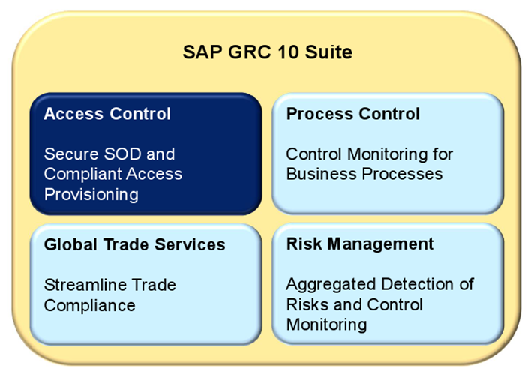
SAP GRC Suite

Slide 14
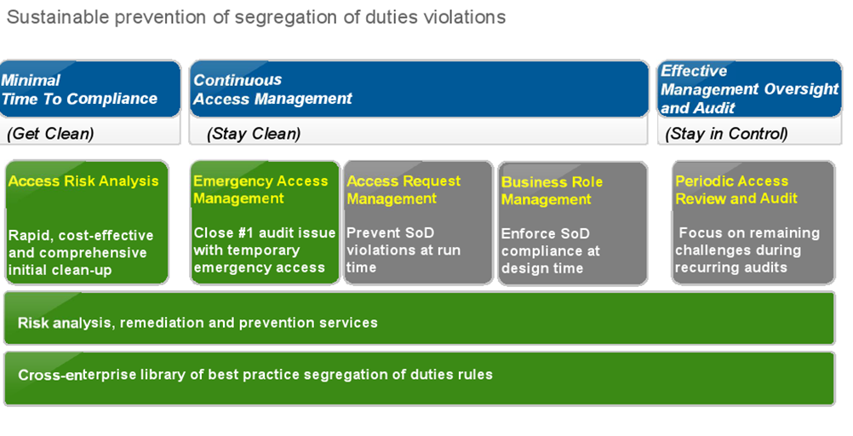
SAP Access Control

Slide 15
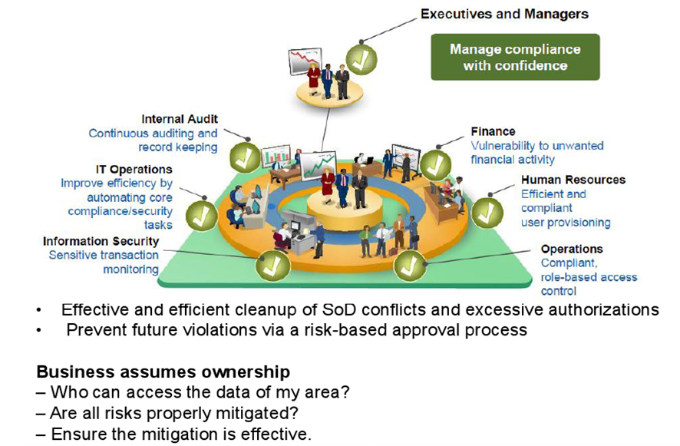
SAP Automated Solution: Access Control

Slide 16
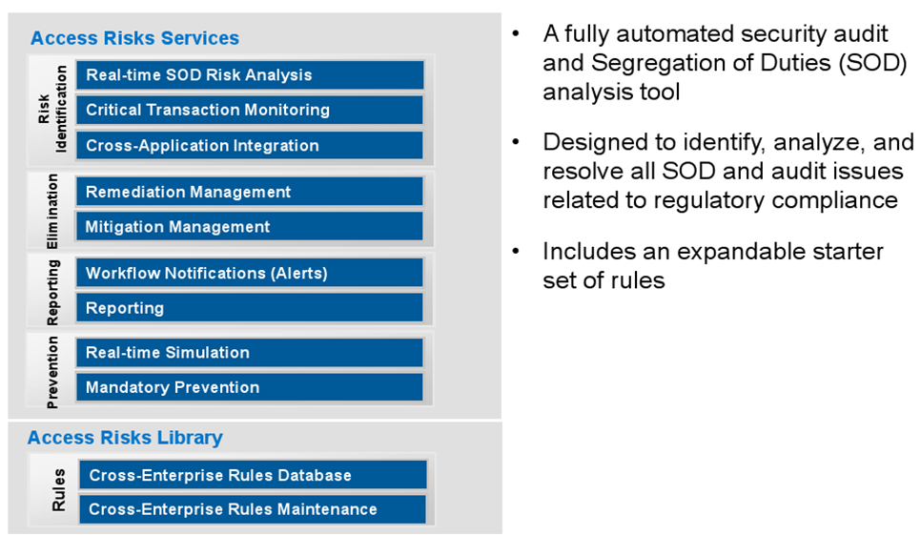
Access Control Analysis

Slide 17
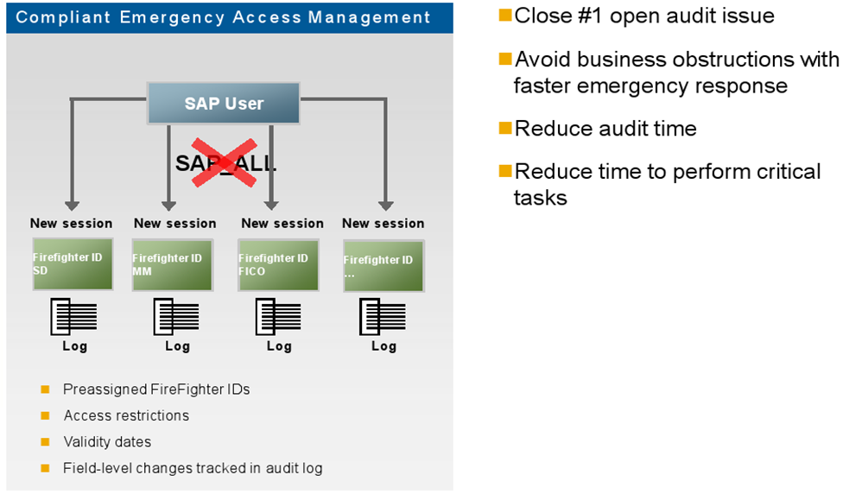
Emergency Access Management

Slide 18
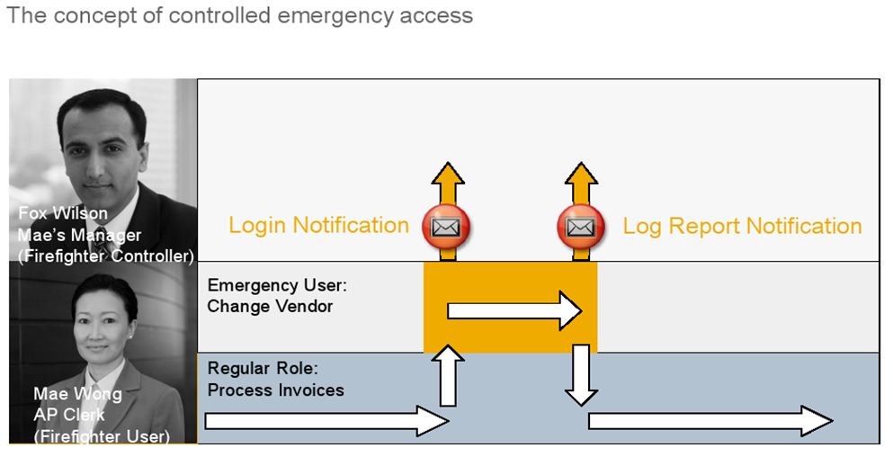
Emergency Access Management

Slide 19
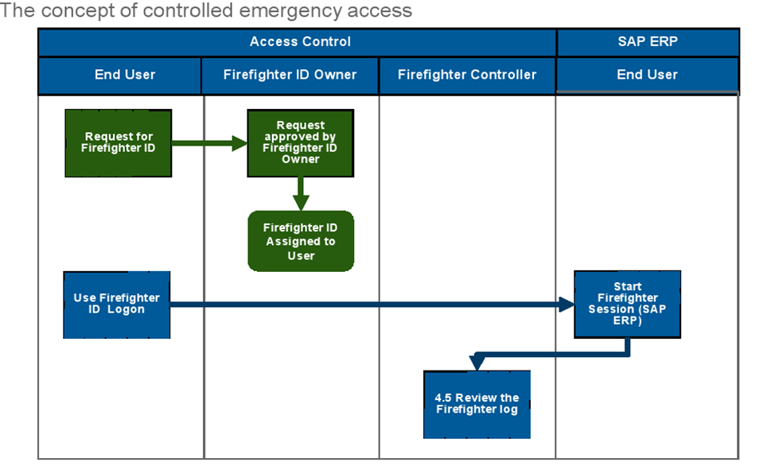
Emergency Access Management

Slide 20
GRC Training Session Overview
Role | Attendee Count | Training Sessions | Duration Estimate
BA | 4 | May 23, Little Cayman, 9-4 | 4 hrs
Risk Owners | 4 | June 3, Little Cayman, 1-3 | 2 hrs
Role Owners | 15 | June 4, 1-4, Gerry's group June 5, 9-1, Basil's group Little Cayman | 4 hrs
BSA | 16 | June 17, 1-5, Frank's group June 19 or 20, 9-1, Siobhan's group W92-206 Classroom | 4 hrs
SOD Coordinator | 1 | In All Sesions | Several days
VPF Firefighters | 12 | June 3, Little Cayman, 3-4 | 1 hr
Help Desk | 1 | See BSA times W92-206 Classroom | 6 hrs

Slide 21
GRC Documentation Overview
Various documented resources are available :
  GRC-related Roles and Responsibilities
  Business events triggering SAP access change
  5 GRC Process Flowcharts, with detailed step descriptions
  Individual GRC Report Job Aids
  Steps for performing an SOD analysis
  GRC System and SAP Access Terminology
  Change request Forms / Checklists
  FireFighter procedures
  Other information from GRC – like Risk definitions

Slide 22
VPF BA Role Overview
GRC Processes and VPF BA involvement
  1 New or Amended Roles Medium involvement
  2 Mitigation Analysis/Design Medium involvement
  3 New User / Role Provisioning Very Light
  4 FireFighter Maintenance/Use FF use only
  5 Periodic Compliance reviews Light

Slide 23
BREAK 1
BRIEF 5 MINUTE BREAK

Slide 24
VPF BA Role – In Detail
GRC Processes and VPF BA involvement
  1 New or Amended Roles Medium involvement
  2 Mitigation Analysis/Design Medium involvement
  3 New User / Role Provisioning Very Light
  4 FireFighter Maintenance/Use FF use only
  5 Periodic Compliance reviews Light

Slide 25
VPF BA Role – In Detail
GRC Processes and VPF BA involvement
  1 New or Amended Roles Medium involvement
    Supporting Role Owner
    Communicating design to R/3 Security Admin
    Assisting with role testing
    Additional Resource : Events triggering role changes

Slide 26
VPF BA Role – In Detail
GRC Processes and VPF BA involvement
  2 Mitigation Analysis/Design Medium involvement
    Understanding the real risk
    Identify existing Mitigation Controls
        Typically these two steps will involve others
    If required, define new Mitigation Controls and test
        Assist Risk Owner with new GRC-related steps
    Additional Resource : SOD Analysis Steps document

Slide 27
VPF BA Role – In Detail
GRC Processes and VPF BA involvement
  3 New User / Role Provisioning Should be very light
    Composite Roles – should have reduced the workload
      All the work was in the Role maintenance process
    May need to assist Role Owner to check role contents

Slide 28
VPF BA Role – In Detail
GRC Processes and VPF BA involvement
  4 FireFighter Maintenance/Use FF use only
    No involvement in FFID assignments
      All the work was in the Role maintenance process
    Using your FFIDs – already trained
    May need to assist FFID Controller to review logs

Slide 29
VPF BA Role – In Detail
GRC Processes and VPF BA involvement
  5 Periodic Compliance reviews Light
    Support Role Owner :
      If unexpected SODs are reported
      If Mitigation Control reports have unusual activity
      Recertification of Mitigation Control assignment
      Role / User, User / Role analysis

Slide 30
BREAK 2
10 MINUTE BREAK

Slide 31
GRC Reports for BAs
Business Analysts are considered GRC Reporting Power Users and have access to all reports in scope for GRC
Business Analysts will use GRC Reports to carry out responsibilities as part of the following GRC processes
  Process 1 : New or Amended Roles
  Process 2 : Mitigation Analysis

Slide 32
Goals for Today’s GRC Reports Session
Help you get comfortable with the GRC Reporting
  Introduce you to tools that are available (Report Job Aids and Reference Documents)
  Demo key reports
    GRC User Level (Report 12)
    GRC User Level Simulation (Report 13)
  GRC Reporting Basics (defining report criteria, saving variants, executing background jobs, etc.)
Have a working session to help you answer your own questions

Slide 33
GRC Reports: Reference Documents
Detailed Reporting 101 documents outlining the basics of using GRC reports
  Action for each step
  Screenshot
Include:
  R1 Access GRC Reporting
  R2 Add or Remove Search Lines to a Report
  R3 Search for Input Values
  R4 Save a Variant
  R5 Execute a Background Job
  R6 Filter a Report
  R7 Change Your Report View
  R8 Export Data from GRC
  R9 Simple Sort

Slide 34
GRC Reports: Job Aids
Detailed procedure documents outlining how to execute each report
  Action for each step
  Screenshot
Numbered to align with the report number assigned to each report
Outline a brief use case scenario
Include steps for different scenarios
Step numbering diverges for each of the scenarios

Slide 35
GRC Reports: Job Aids
01 Risk Violations
02 User Analysis
03 Violations Comparisons
04 Access Rule Library
05 SUIM Roles by Role Name
06 User to Role Relationship
07 Role Relationship with User - User Group
08 SUIM Users by User ID
09 Count Authorizations for Users
10 Action Usage by User Role and Profile
11 Mitigation Control Report
12 User Level
13 User Level Simulation
14 Role Level
15 Role Level Simulation
16 Profile Level
17 Profile Level Simulation

Slide 36
Why do BAs need GRC Reports?
SUIM Roles by Role Name (Report 05)
  What single roles are in this composite role?
GRC User to Role Relationship (Report 06)
  Which users have access to this role?
GRC Role Relationship with User - User Group (Report 07)
  Which roles does this user (or set of users) have?
SUIM Users by User ID (Report 08)
  What is the difference between these users’ access?
GRC Count Authorizations for Users (Report 09)
  What are all the roles and profiles assigned to a user (or set of users)?
GRC Action Usage by User Role and Profile (Report 10)
  Do users really need this transaction that’s in their roles?
GRC Mitigation Control Report (Report 11)
  What risks is this control supposed to be mitigating?
GRC User Level (Report 12)
  Does this user (or set of users) have any unmitigated SODs?
GRC User Level Simulation (Report 13)
  If we give this user (or set of users) this new transaction, will that cause new SODs?

Slide 37
GRC Reports: Demo
SUIM Roles by Role Name (Report 05)

Slide 38
GRC Reports: Demo
GRC User Level (Report 12)

Slide 39
GRC Reports: Demo
GRC User Level Simulation (Report 13)

Slide 40
GRC Reports: Demo
101 Basics

Slide 41
Working Session
Using GRC Reports to find answers to our authorizations and SOD questions.
If you have a question, try using the Job Aids or Reference Documents!
If you still have a question, please feel free to ask.

